Slide 1
UNIT – III: Constraint Satisfaction problems- Backtracking search for CSP’s, Local search for CSP
Game Playing: Adversarial search, Games, Minimax algorithm, optimal decisions in multiplayer games, Alpha-Beta pruning, Evaluation functions, cutting of search

Slide 2
Constraint Satisfaction problems-
Constraint Satisfaction Problems (CSPs) are a class of computational problems where the goal is to find a solution that satisfies a set of constraints.
solving a problem under certain constraints or rules.
They model a wide range of real-world problems where decision-making is subject to certain conditions and limitations.
CSPs offer a structured and general framework for representing and solving problems, making them versatile in problem-solving applications.
Many AI applications, such as scheduling, planning, and configuration, can be mapped to CSPs, allowing AI systems to find optimal solutions efficiently.

Slide 3
Constraint Satisfaction problems-
Constraint satisfaction depends on three components, namely:
X: It is a set of variables.
D: It is a set of domains where the variables reside. There is a specific domain for each variable.
C: It is a set of constraints which are followed by the set of variables.

Slide 4
Constraint Satisfaction problems-
Constraint Types in CSP
With respect to the variables, basically there are following types of constraints:
Unary Constraints: It is the simplest type of constraints that restricts the value of a single variable.
Binary Constraints: It is the constraint type which relates two variables. A value x₂ will contain a value which lies between x1 and x3.
Global Constraints: It is the constraint type which involves an arbitrary number of variables.

Slide 5
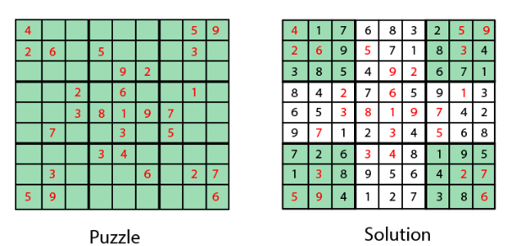
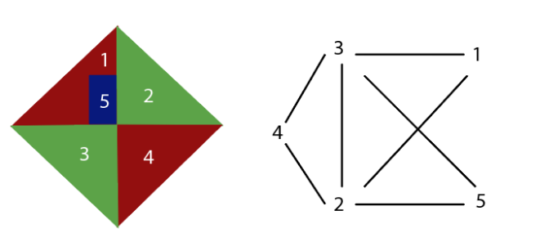
Constraint Satisfaction problems-
Graph Coloring: The problem where the constraint is that no adjacent sides can have the same color.
Sudoku Playing: The game play where the constraint is that number from 0-9 can not be repeated in the same row or column.

Slide 6
Constraint Satisfaction problems-
n-queen problem: In n-queen problem, the constraint is that no queen should be placed either diagonally, in the same row or column.
Crossword: In crossword problem, the constraint is that there should be the correct formation of the words, and it should be meaningful.
Latin square Problem: In this game, the task is to search the pattern which is occurring several times in the game. They may be shuffled but will contain the same digits.
Cryptarithmetic Problem: This problem has one most important constraint that is, we cannot assign a different digit to the same character. All digits should contain a unique alphabet.

Slide 7

Example: Map-Coloring
Variables WA, NT, Q, NSW, V, SA, T
Domains D_{i} = {red,green,blue}
Constraints: adjacent regions must have different colors
e.g., WA ≠ NT

Slide 8

Example: Map-Coloring
Solutions are complete and consistent assignments, e.g., WA = red, NT = green,Q = red,NSW = green,V = red,SA = blue,T = green

Slide 9
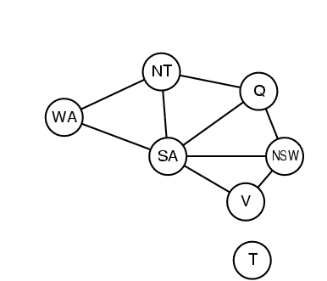
Constraint graph
Binary CSP: each constraint relates two variables
Constraint graph: nodes are variables, arcs are constraints

Slide 10
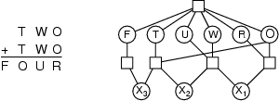
Example: Cryptarithmetic
Variables: F T U W R O X₁ X₂ X₃
Domains: {0,1,2,3,4,5,6,7,8,9} {0,1}
Constraints: Alldiff (F,T,U,W,R,O)
  O + O = R + 10 · X₁
  X₁ + W + W = U + 10 · X₂
  X₂ + T + T = O + 10 · X₃
  X₃ = F, T ≠ 0, F ≠ 0

Slide 11
Sudoku puzzle
Variables: 9x9 grid cells
Domains: Numbers from 1 to 9
Constraints: No number can repeat in the same row, column, or 3x3 subgrid.
Step 1: Start with an empty Sudoku grid.
Step 2: Apply the initial constraints for the given numbers, reducing the domains of variables based on the puzzle's clues.
Step 3: Use constraint propagation to narrow down the domains further. For example, if a row has two cells with domains {2, 5}, and the constraint specifies that these two cells cannot have the same number, we can eliminate the possibility of 5 for one of them.
Step 4: Continue applying constraints and propagating until the domains of variables are either empty or filled with single values. If they are all filled, you have a valid solution. If any variable's domain is empty, you backtrack to the previous step and try an alternative assignment.

